Slide 1
Secure Data Hiding in Image Using Steganography
CAPSTONE PROJECT
Presented By: Juhi N Poddar
Student Name : Juhi N Poddar
College Name & Department : IIT Patna AI&DS

Slide 2
OUTLINE
Problem Statement
Technology used
Wow factor
End users
Result
Conclusion
Git-hub Link
Future scope

Slide 3
Problem Statement
Faced problem in libraries and execution.

Slide 4
Technology used
Technology Used: Python , Cmd
Libraries : cv2, os module , numpy , string
Operating System : Windows 10
Hardware Requirements: Core i3 or higher,(cache- 3MB or 4MB recommended) , Memory(RAM): Minimum 2GB

Slide 5
Wow factors
The wow factor of this project is that the code is inside the image which is not visible without the secreat code.
AES

Slide 6
End users
The bankers who are using this software Steganography.

Slide 7
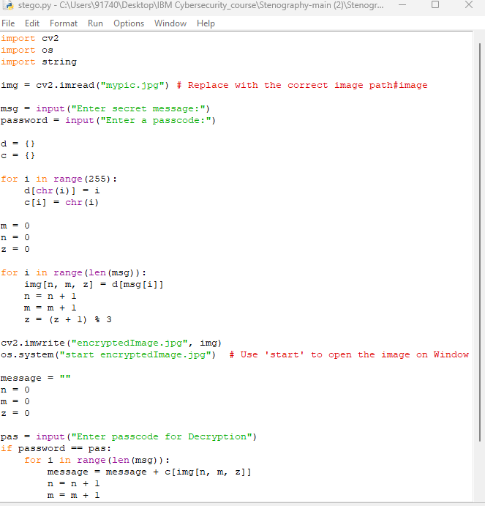
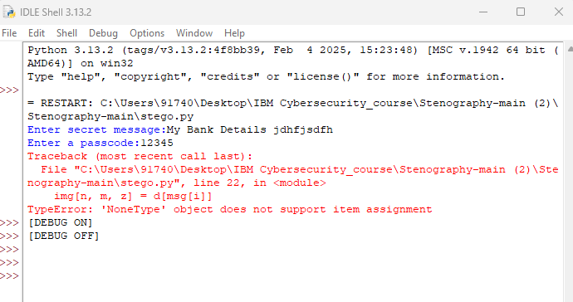
Results

Slide 8
Conclusion
Conclude your project concerning your problem statement

Slide 9
GitHub Link
https://github.com/Jpoddar26/stegano_proj.git

Slide 10
Future scope(optional)
Though our project is able to reach highly accepted results and is able to hide data very efficiently, it can definitely be improved in some areas.
To make the communication more secured and impossible to hack, various existing ciphers can be implemented with the steganography algorithms.

Slide 11
THANK YOU

